Slide 1
Program 4
Mickey Ma (马毓琦): mickeyma@cuhk.edu.cn
Office: Teaching C Building Room 402(TC-402)
Phone: 0755-23519635

Slide 2
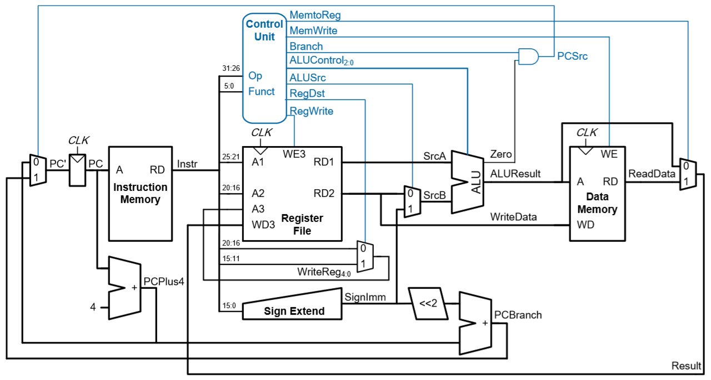
Single-cycle MIPS Processor

Slide 3
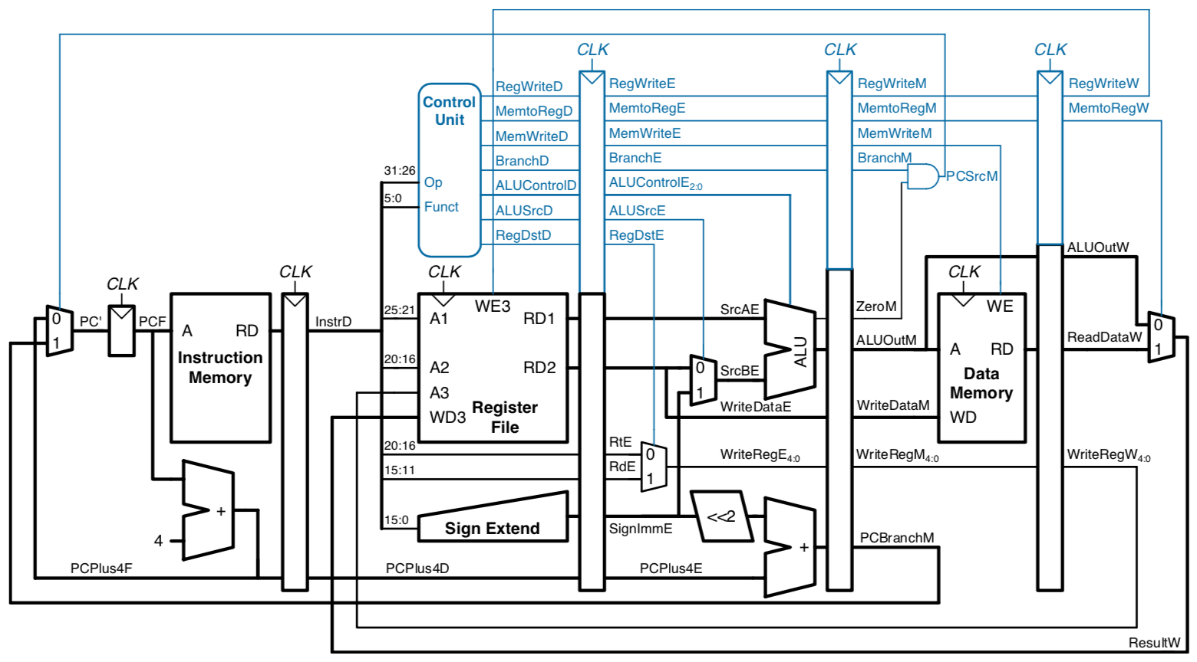
Pipelined Processor with Control

Slide 4
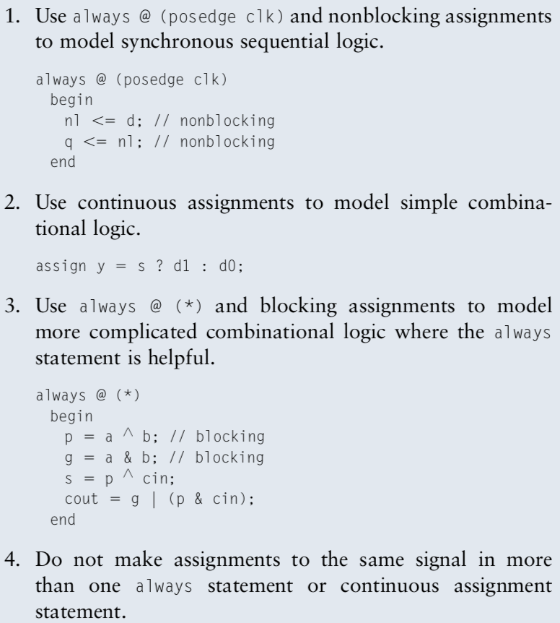
Blocking and non-blocking assignments
Example:
a = 1; b = 2; c = 0;
1.
always @ (*)
begin
b <= a;
c <= b;
end
end
//We will get b = 1, c = 2
2.
always @ (*)
begin
b = a;
c = b;
end
end
//We will get b = 1, c = 1

Slide 5
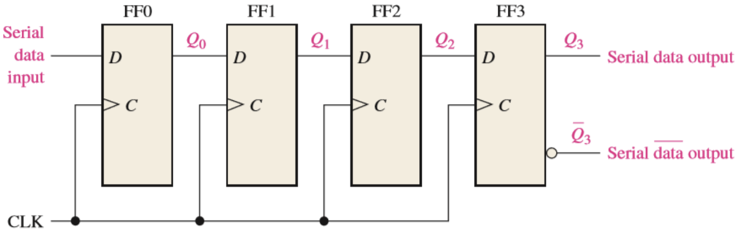
Example: Shift register

Slide 6
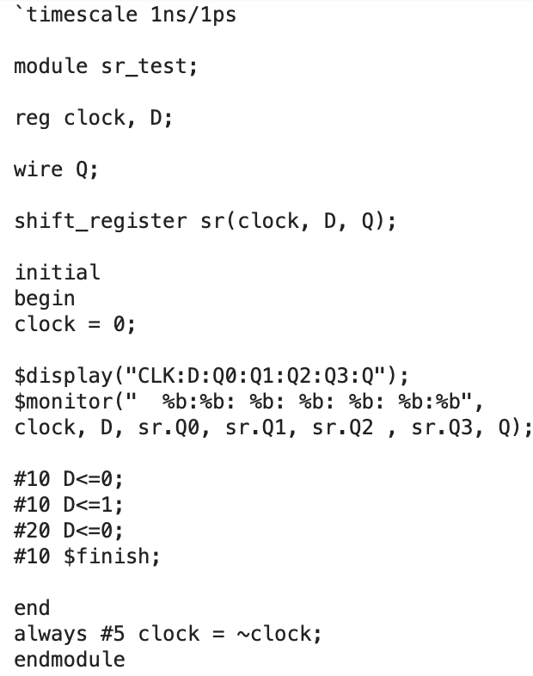
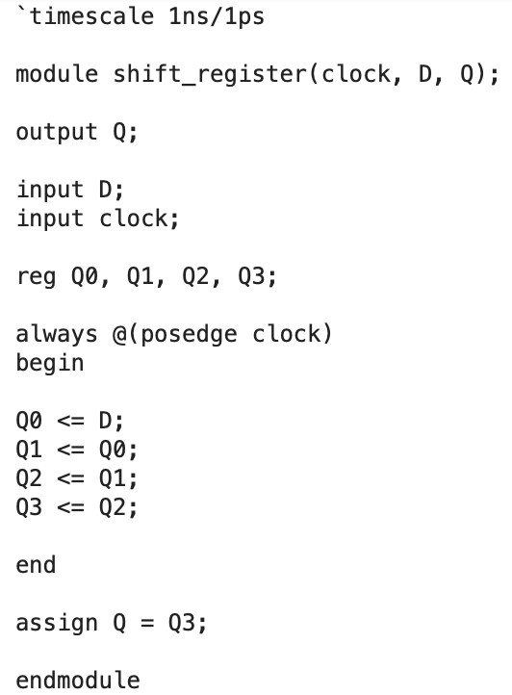

Slide 7
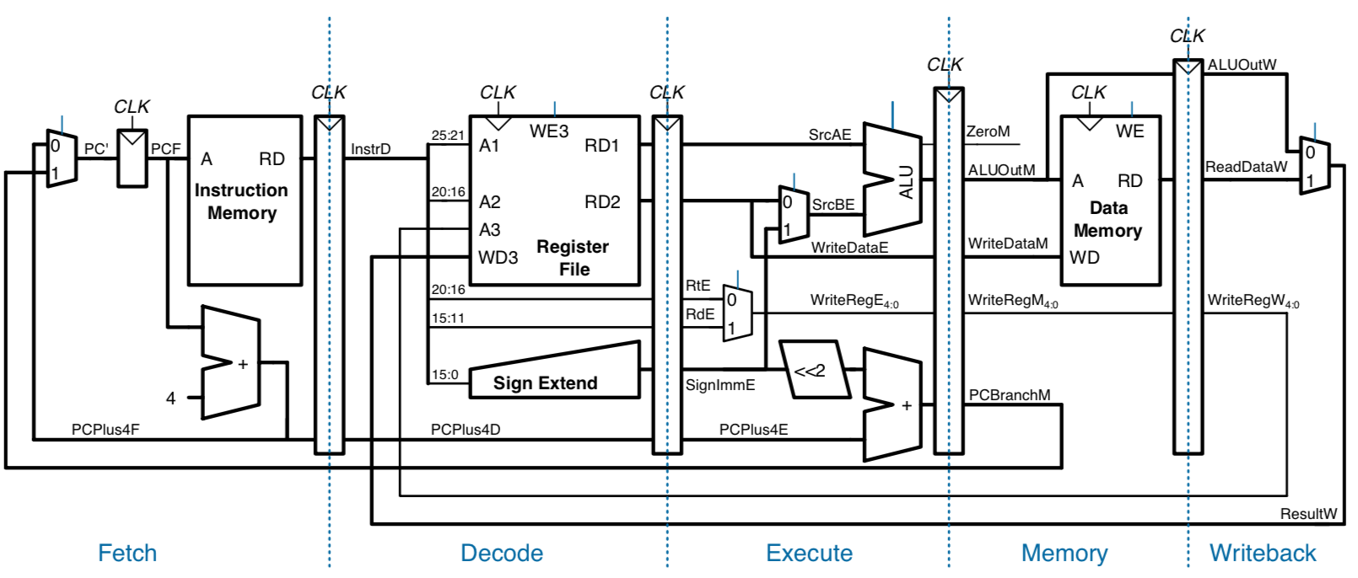
Pipelined Datapath

Slide 8
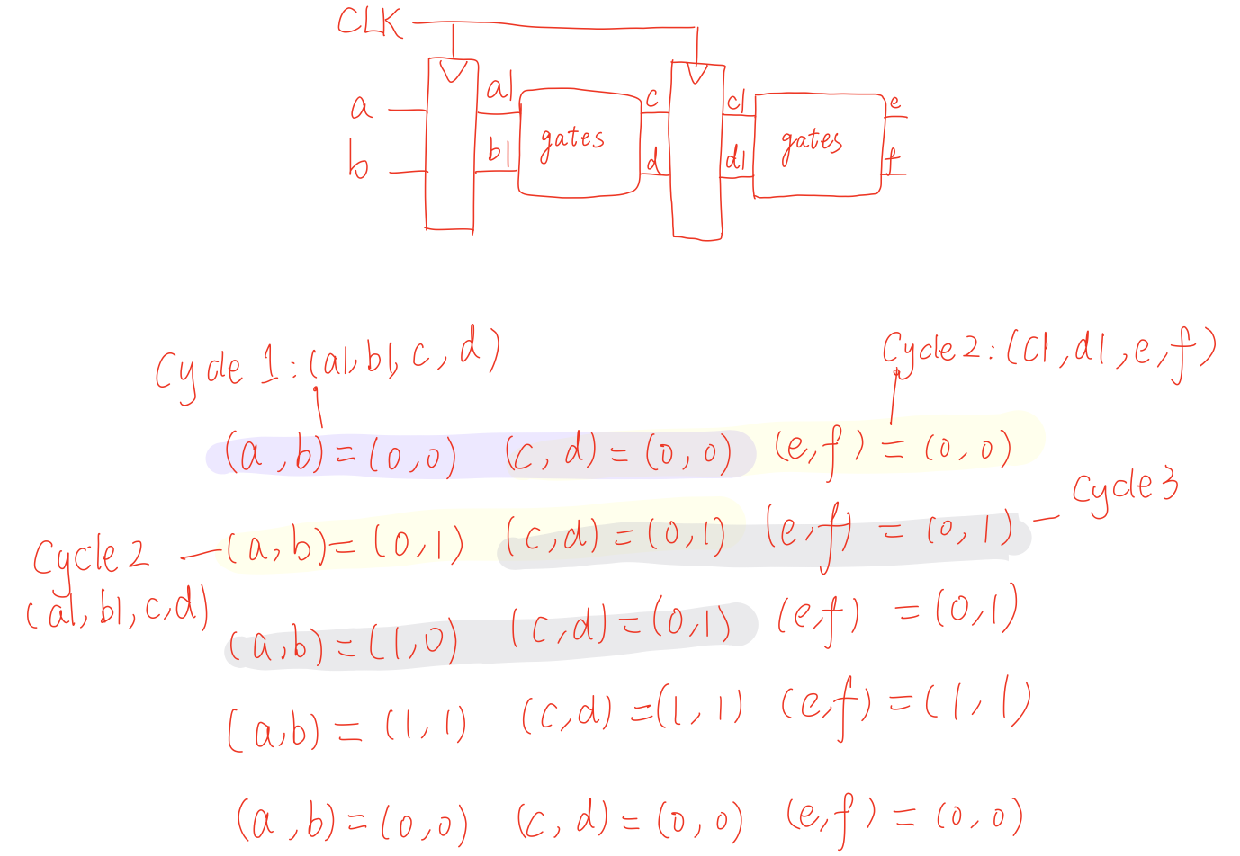

Slide 9
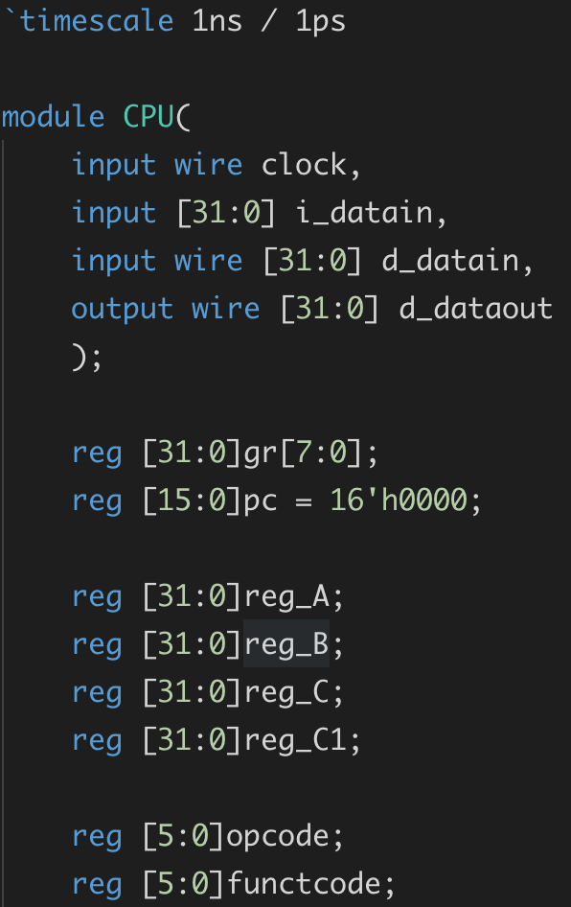
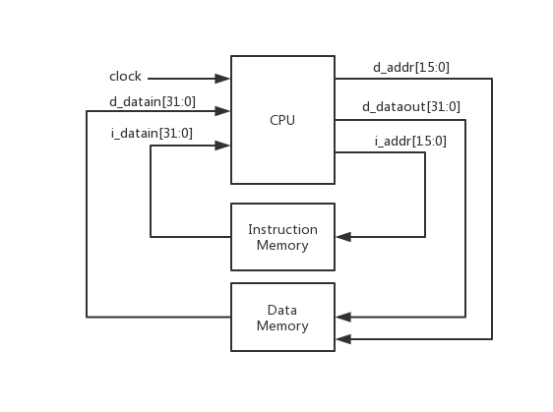
Top View
[31:0]
[31:0]
CPU.v

Slide 10
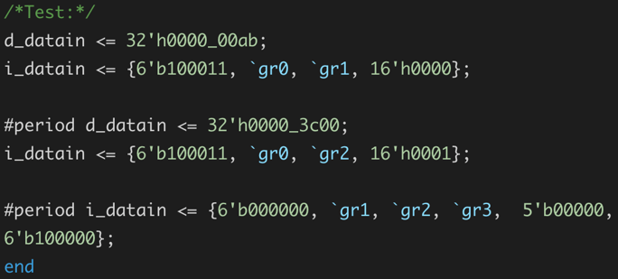
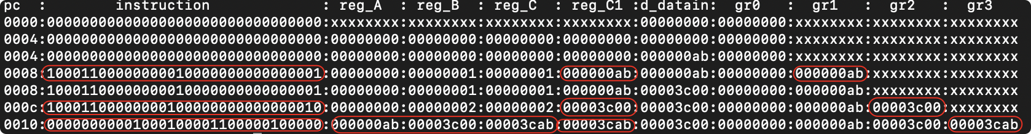
Result

Slide 11
Revision
Lecture 4: Arithmetic and logic unit (Project 3)
Lecture 5: Datapath
instruction (Project 3)
combinational logic: logic gates, adder, multiplexer(Project 3)
sequential logic: clock (Project 4)
datapath of cpu: pc, memory, ALU, control unit
examples: load&store, add&addi, beq, j
Lecture 6: Pipelining
brief introduction
hazards

Slide 12
Single-cycle MIPS Processor

Slide 14
Pipelined Processor with Control

Slide 15
Pipelined Datapath

Slide 16
Hazards

Slide 17
Hazards
Type of hazards:
Structural hazards
Data hazards
Control hazards
Handling hazards:
Inserting NOP（software）
Forwarding, R-Type-use（hardware)
Stalls, load-use (hardware)
Special dealing with branch instruction

Slide 18
Pipelined Processor with Control

Slide 19
Data Forwarding

Slide 20
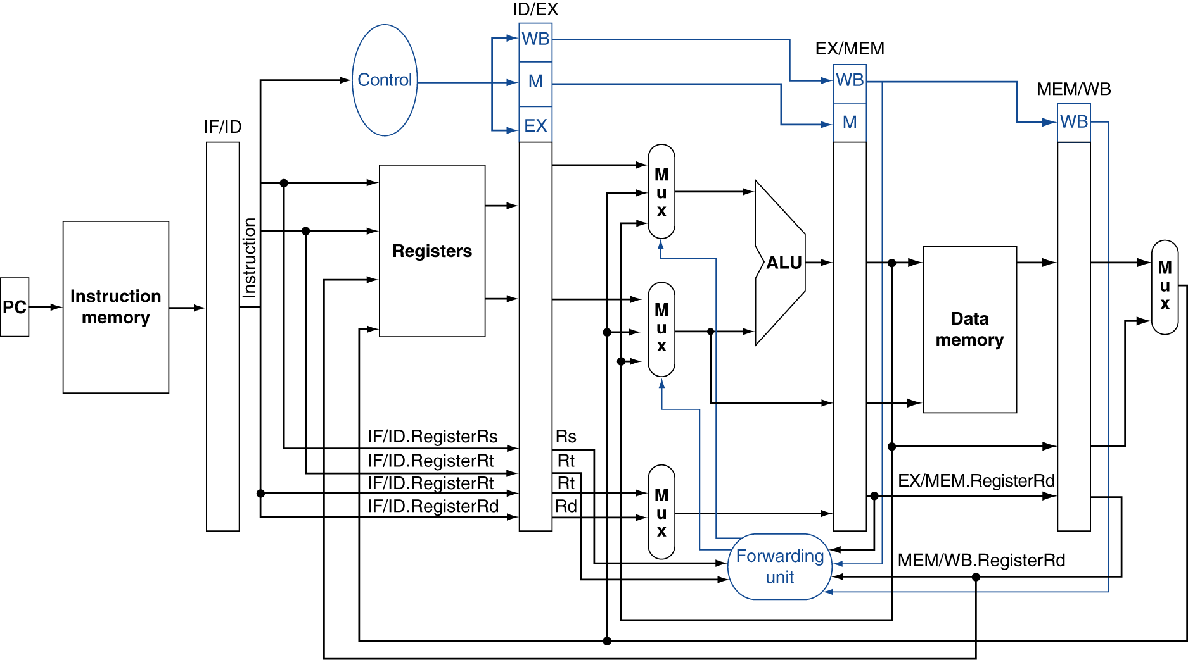
Data Forwarding

Slide 21
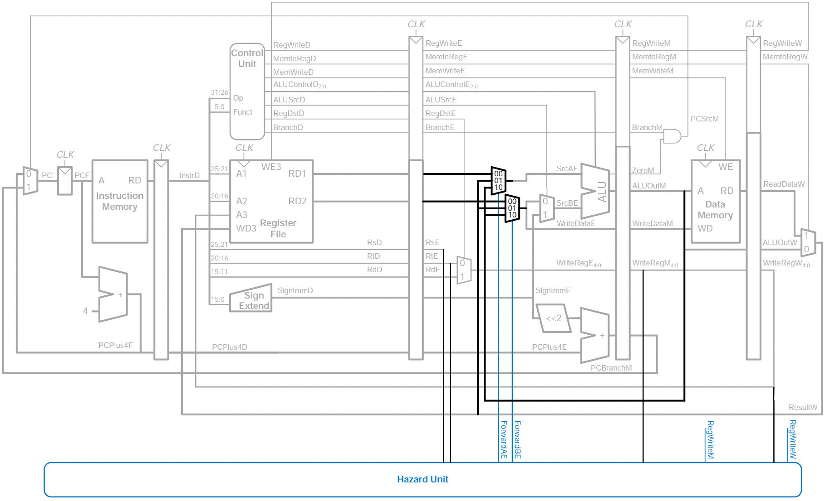
Pipelined Processor with Data Forwarding

Slide 22
Stalling

Slide 23
Stalling

Slide 24
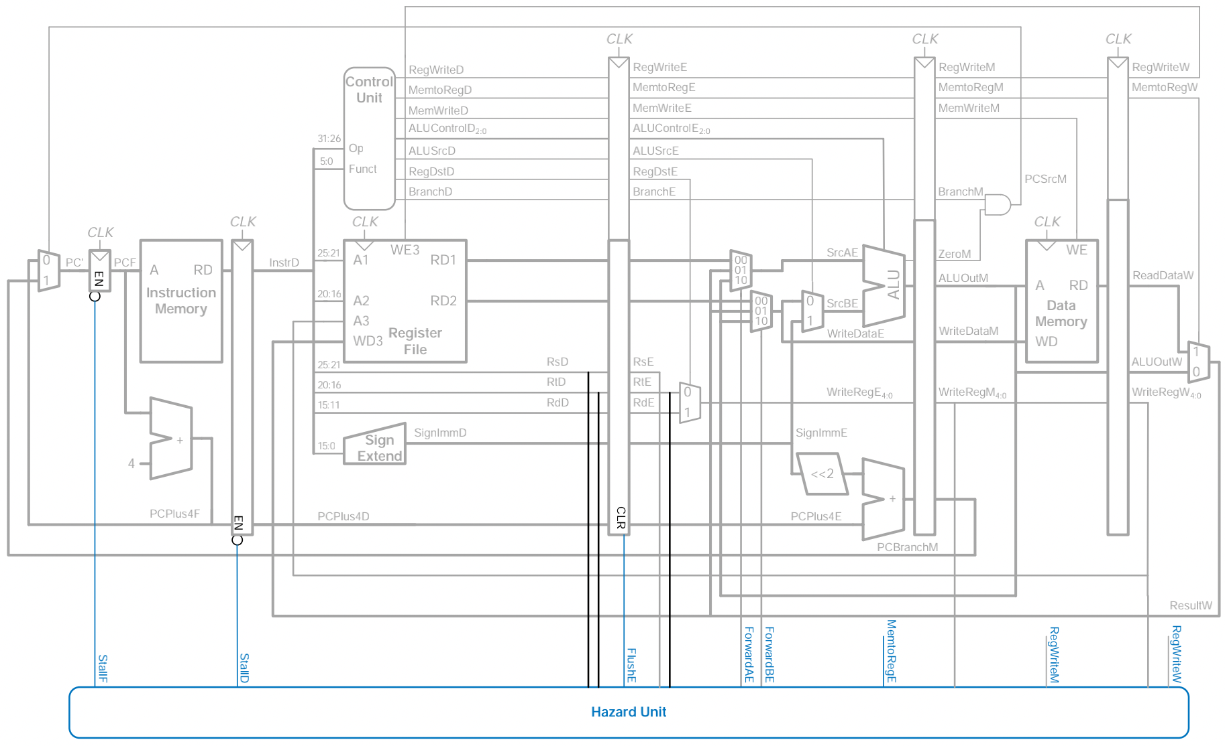
Pipelined Processor with Stalls

Slide 25
Branch

Slide 26
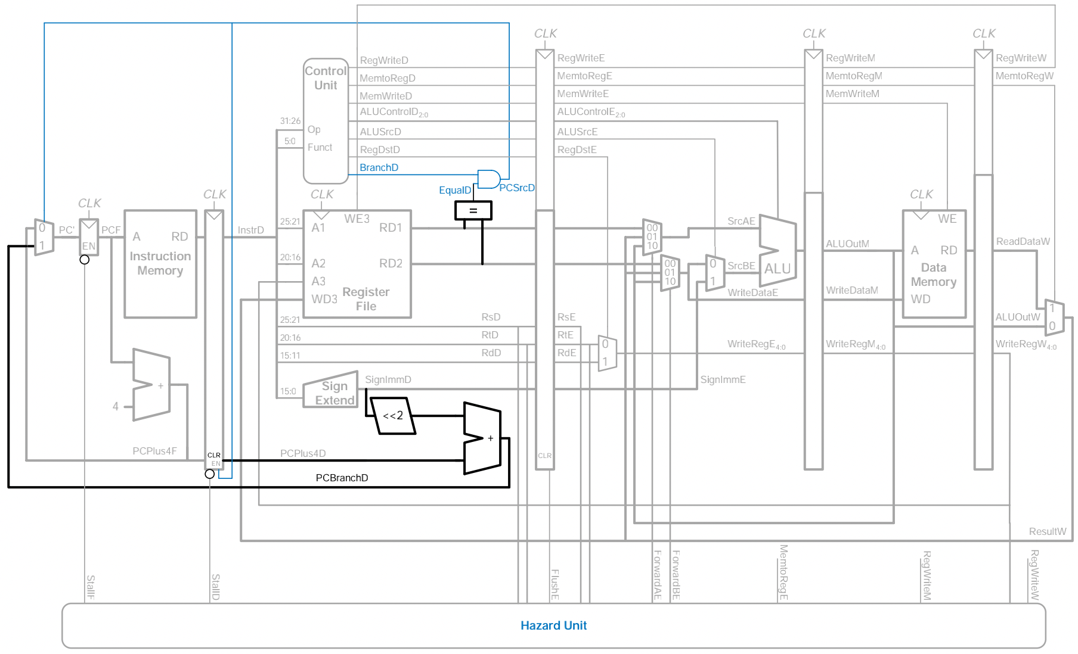
Branch

Slide 27
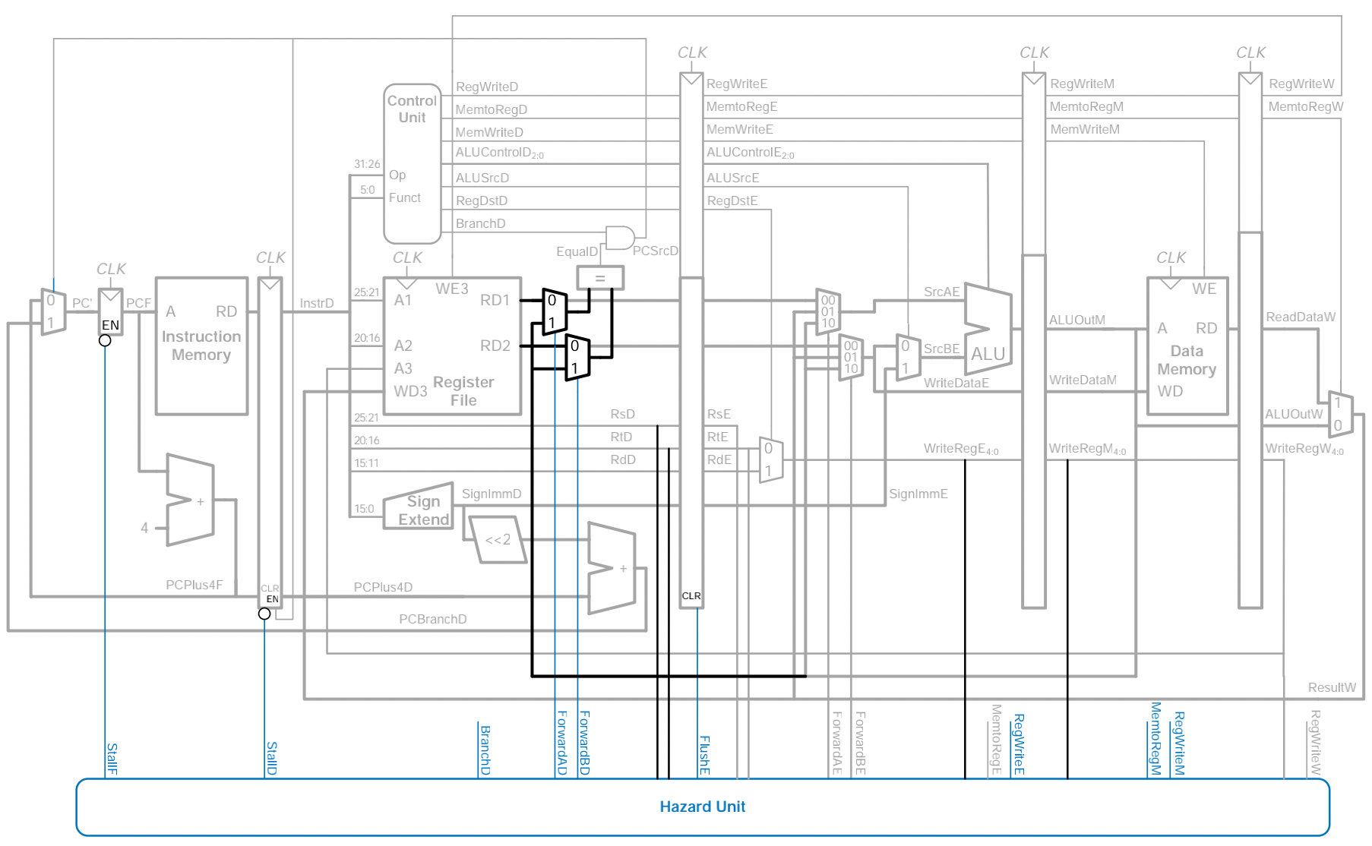
Pipelined Processor with full hazard handling

